Slide 1
Coastal Zone Management Act Overview
Overview
Notes:
These slides provide an overview of the Coastal Zone Management Act, federal legislation often referred to as the CZMA.

Slide 2
Relevance to new coastal program staff
Do I really need to know about the CZMA and its regulations and programs?
While it may not always be obvious, the federal CZMA is an integral part of all state CZM (coastal zone management) programs.
As a new staff person to the coastal management program, you may be wondering if it really is necessary to know about the CZMA and its regulations and programs.
What’s the big deal if I don’t?
Notes:
While it may not always be obvious, the federal CZMA is an integral part of all state CZM (coastal zone management) programs.
As a new staff person to the coastal management program, you may be wondering if it really is necessary to know about the CZMA and its regulations and programs.

Slide 3
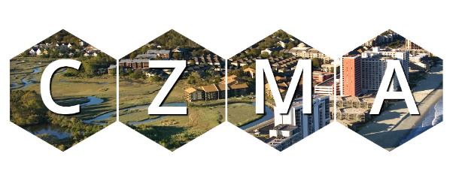
How your work relates to the CZMA
Coastal Zone
Coastal Management
Programs
NERRS
You are here
Connections
Coastal
States
and Territories
Federal
Partnership
Notes:
State CZM programs are directly related to and supported by this national legislation and the federal-state partnership it creates.

Slide 4
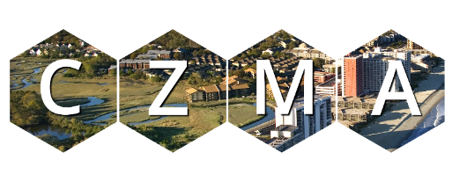
How your work furthers coastal management goals
Preserve
Protect
Develop
Coastal Zone
Enhance
Coastal Management
Program
Connections
Restore
You are here
Coastal
States
and Territories
Federal
Partnership
Notes:
Your work furthers local, state, and national coastal management goals, including efforts to
protect natural resources;
manage development in high hazard areas;
give development priority to coastal-dependent uses;
provide public access for recreation;
prioritize water-dependent uses; and
coordinate state and federal actions.

Slide 5
Your CZMA partners
Coastal Zone
Coastal Management
Programs
NERRS
You are here
Connections
Coastal
States
/ Territories
Federal
Partnership
Notes:
The national legislation also supports a system of estuarine research reserves around the country, often referred to as NERRS (National Estuarine Research Reserve System). You will learn more about them throughout this presentation.
Understanding the role of the state programs, the reserves, and the federal-state partnership, and how to access resources made available through this CZM network will be helpful.

Slide 6
Imagine…
Your coastal management program is considering a living shorelines policy.
And you are responsible for leading the development of this plan.
Scenario
Notes:
EXAMPLE
Your coastal management program is considering a living shorelines policy.
Staff are determining whether a policy is needed and the effort required to draft one. You are charged with leading this effort.
How might knowledge of the CZMA help with this task?

Slide 7
Real world scenario
The CZMA program links you to
peers working on similar projects.
research reserve-based research and related training and outreach.
guidance about processes and requirements.
contacts with NOAA’s Office for Coastal Management for technical assistance, information, funding resources, and review and approval requirements.
Scenario
Notes:
If you have knowledge of the CZMA
You would know
there are 34 coastal management programs and many are working on living shorelines.
many reserves conduct research on this topic and provide training and outreach support.
You could reach out to these programs and obtain first-hand knowledge, materials, and lessons learned.
You would know a NOAA review and approval must be a part of the process for new policies incorporated into your approved program.
You could reach out to NOAA’s Office for Coastal Management for resources and guidance.
_______________________________________
Presenter - talk about your program.
Share a scenario when your staff might need to know about or reference the CZMA.

Slide 8
Real world scenario continued
So imagine the consequences of not knowing about the CZMA...
Scenario
Notes:
So imagine the consequences of doing your job without knowing about the CZMA.
Presenter: Pause for a moment and let the audience think about this or take a moment to discuss before continuing.
Understanding the CZMA and the national program will provide savings in terms of time, money, and effort, and will make your work and your program more effective.

Slide 9
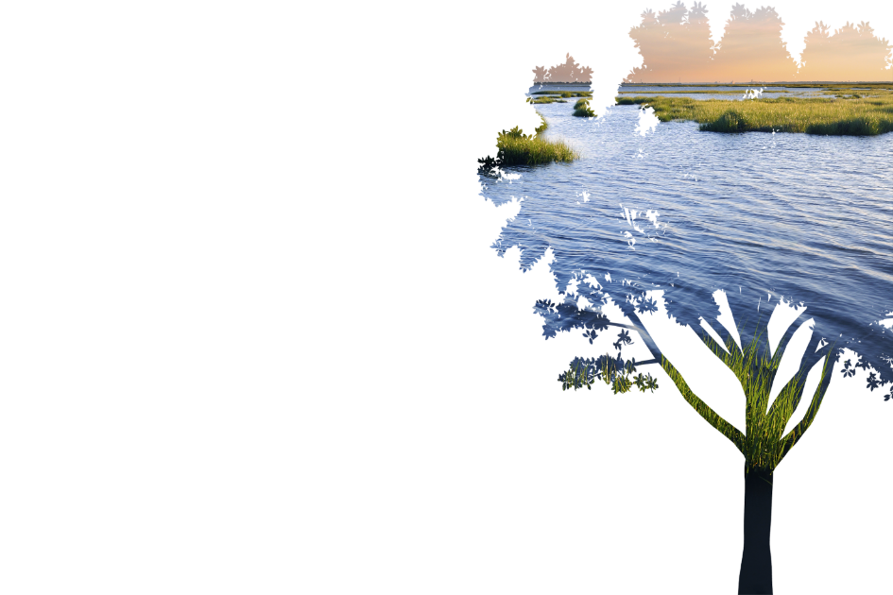
Table of contents
Part 1 Overview
​ How it works​
Key Points
Quiz​
Part 2
Eight Good-to-Know CZMA Sections
Notes:
To provide a basic understanding of the CZMA, this presentation will provide
Part 1
a legislation overview;
an explanation of the how the CZMA program works;
key points to remember about the CZMA; and
a short quiz on Part 1 of this presentation.
Part 2
An overview of the eight CZMA sections coastal management program staff frequently use.
_______________________________________
Presenter – notes
Part 1
overview; how it works; (slides 10-30)
key points (slides 31-36)
quiz link (slide 38)
Part 2
eight CZMA sections (slides 39-57)

Slide 10
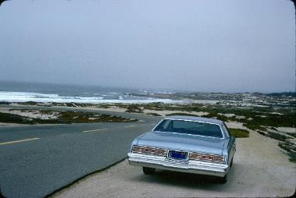
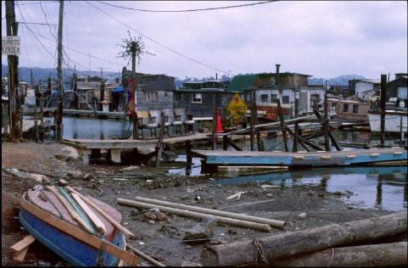
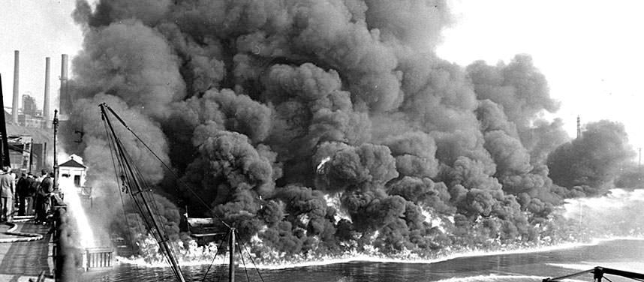
State of the Coast 45+ years ago
Notes:
To understand the Coastal Zone Management Act, it is helpful to understand what the coasts were experiencing back then. In the late 1960s,
The coast was under pressure from population growth and economic development.
There were increasing and competing demands for using coastal lands and waters.
Competing uses included industry, commerce, residential development, recreation, extraction of mineral resources and fossil fuels, transportation and navigation, waste disposal, and commercial fishing.
These uses were affecting the marine resources, wildlife, and coastal and estuarine ecosystems. There were challenges balancing the conflicts arising because of the competing demands.
Congress recognized the importance of the coast and the need to address these challenges.
Cuyahoga River Photo Courtesy of: Cleveland Press Collection at Cleveland State University Library.

Slide 11
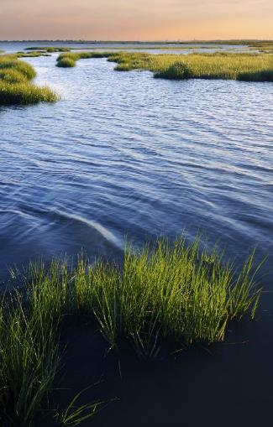
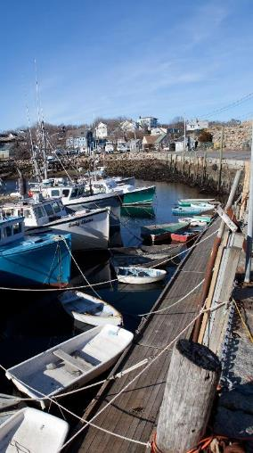
Coastal Zone Management Act (CZMA)
Notes:
In the 1970s proposals for national land use legislation were considered but never adopted. However, Congress felt the coastal zones were so important to the future of the nation that the CZMA was enacted in 1972. Much of it was based on a 1969 presidential blue ribbon “Stratton Commission” report focusing on marine issues.
The Act created two primary programs
the National Coastal Zone Management Program, and the
National Estuarine Research Reserve System.
State participation in these programs is voluntary, and the emphasis is on a state and federal partnership approach to addressing coastal zone issues.
Let’s look at the two programs in more detail.

Slide 12
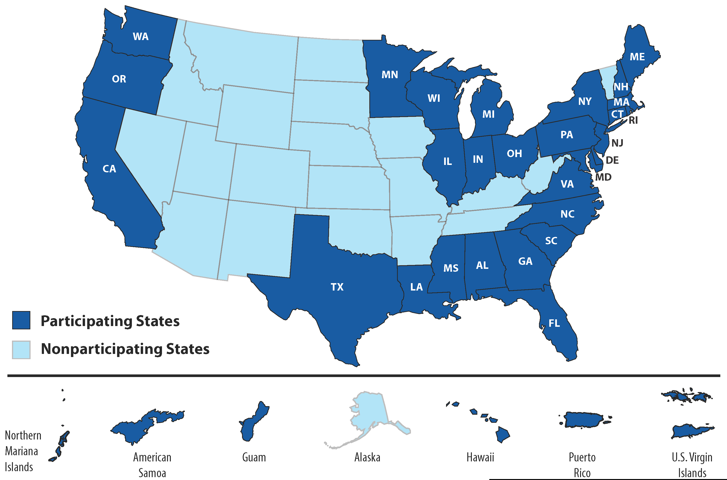
National Coastal Zone Management Program
34 State Programs
Notes:
Coastal zone management programs are designed to
Preserve, protect, develop, and, where possible, restore and enhance the natural resources found in the coastal zone by
developing and implementing comprehensive, coastal land and water use planning and management programs.
Congress believed the most productive approach would be to encourage states to exercise their full authority over coastal lands and waters through state-based land and water use programs for the coastal zone. Since each program is based on requirements found in the CZMA, national priorities are being met, and yet states have the flexibility to design programs that meet each state’s specific needs and situations.
Since the CZMA was adopted, all coastal states, Great Lake states, and U.S. territories and commonwealths, have developed coastal management programs approved by Secretary of Commerce.
The first program approved was Washington in 1974 and the most recent state to join was Illinois in 2012.
Currently, 34 of the 35 eligible programs are participating. Alaska withdrew from the program in 2011.
_______________________________________
Presenter - talk about your program:
Share the date your program was approved.

Slide 13
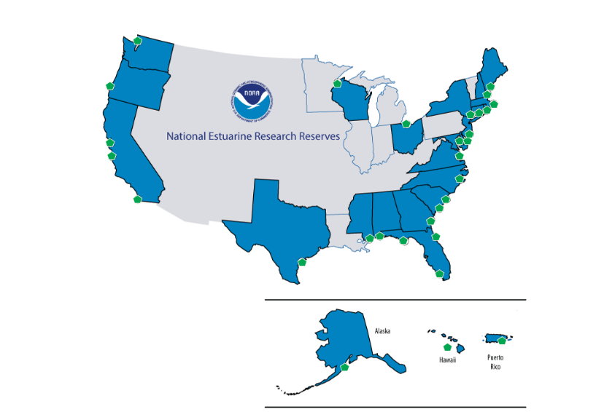
National Estuarine Research Reserve System
29 Sites
Notes:
The National Estuarine Research Reserves System is a network of 29 coastal sites engaged in long-term research, environmental monitoring, education, and stewardship, all of which are designed to help communities and the nation meet coastal management goals.
The first reserve designation was Oregon’s South Slough research reserve in 1974.
The most recent addition is the He'eia research reserve in Hawaii in 2017.
Twenty-three states and Puerto Rico have research reserves.
_______________________________________
Presenter - talk about your program:
Share the name and location of the research reserve(s) in your state (if applicable) and date when reserve was designated.

Slide 14
The CZMA network increases effectiveness
Coastal Zone
34
Coastal Management
Programs
29
NERRS
You are here
Connections
35
Coastal
States
and Territories
Federal
Partnership
Notes:
Your work as part of a coastal management program contributes to state coastal management goals and national CZMA goals.
Learning how the CZMA connects to your coastal management program provides the context needed to see the big picture and how membership in the CZM network helps you and your program increase effectiveness.

Slide 15
CZMA Approaches and Support
Financial
Resources
Technical
Resources
National
Network
Science
Based
Partnership
Support
Catalyst for
Problem
Solving
Voluntary
Leverages
Resources
Coordination
Collaboration
Flexible
Structure
Community
Support
Proactive
Notes:
The CZMA provides the operational framework for state coastal management programs. This image shows various approaches the CZMA encourages, as well as types of support the CZMA provides. These topics are described in more detail in this presentation.
Voluntary
Partnership-based
Comprehensive in scope
Multi-purposed, balanced approach
Versatile and flexible structure
Facilitate coordination and collaboration
Catalyst for problem solving
Science-based
Works across all government levels
Provide local community support
Provides financial resources
Provide technical assistance
Leverages resources
Creates a national network
Proactive in addresses emerging and long-term issues
What does it mean to be a federally-approved coastal management program? To unpack this question, we will start with some of the common elements these programs include.

Slide 16
Emphasis:
Comprehensive Balanced
Proactive
Coordinated
Notes:
The CZMA emphasizes an approach that is
Comprehensive, both in terms of addressing coastal issues and coordinating across stakeholders;
Balanced, focusing not only on environmental protection, but also on supporting responsible, appropriately-sited development;
Proactive, addressing both emerging and long-standing coastal management issues; and
Coordinated, supporting partnerships and coordination at federal, state, and local levels.

Slide 17
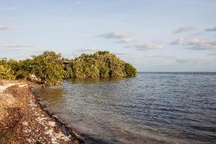
Coastal Management Program Goals 1
Protecting natural resources
Notes:
CZMA also outlines a number of common goals for coastal programs to address when managing land and water resources.
These may sound familiar.
Protecting natural resources
Managing development in high hazard areas
Giving development priority to coastal-dependent uses
Providing public access for recreation
Improving coastal water quality
Coordinating state and federal actions
Involving the public

Slide 18
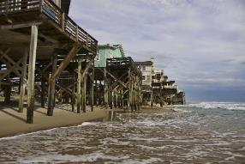
Coastal Management Program Goals 2
Managing development in high hazard areas
Notes:
Protecting natural resources
Managing development in high hazard areas
Giving development priority to coastal-dependent uses
Providing public access for recreation
Improving coastal water quality
Coordinating state and federal actions
Involving the public

Slide 19
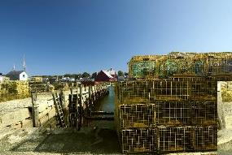
Coastal Management Program Goals 3
Giving development priority to coastal-dependent uses
Notes:
Protecting natural resources
Managing development in high hazard areas
Giving development priority to coastal-dependent uses
Providing public access for recreation
Improving coastal water quality
Coordinating state and federal actions
Involving the public

Slide 20
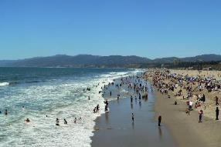
Coastal Management Program Goals 4
Providing public access for recreation
Notes:
Protecting natural resources
Managing development in high hazard areas
Giving development priority to coastal-dependent uses
Providing public access for recreation
Improving coastal water quality
Coordinating state and federal actions
Involving the public

Slide 21
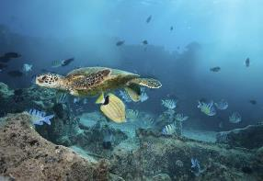
Coastal Management Program Goals 5
Improving coastal water quality
Notes:
Protecting natural resources
Managing development in high hazard areas
Giving development priority to coastal-dependent uses
Providing public access for recreation
Improving coastal water quality
Coordinating state and federal actions
Involving the public

Slide 22
Coastal Management Program Goals 6
Coordinating state and federal actions
Notes:
Protecting natural resources
Managing development in high hazard areas
Giving development priority to coastal-dependent uses
Providing public access for recreation
Improving coastal water quality
Coordinating state and federal actions
Involving the public

Slide 23
Coastal Management Program Goals 7
Involving the public
Notes:
Protecting natural resources
Managing development in high hazard areas
Giving development priority to coastal-dependent uses
Providing public access for recreation
Improving coastal water quality
Coordinating state and federal actions
Involving the public
Across the National Coastal Zone Management Program, these are common goals addressed by the individual programs.
Next, we will talk about how programs are set up to achieve CZMA goals.
_______________________________________
Presenter - talk about your program:
Describe how your coastal management program focuses on one or more of these areas.
Questions for participant(s):
What coastal resources exist in our state?
What kinds of coastal hazards pose risks to development?
Have you visited a beach using a public access point?
Does our coastline include urban waterfronts?
What are examples of cultural, historic, or visual features in our coastal areas?
Add photos from the state to exemplify the above

Slide 24
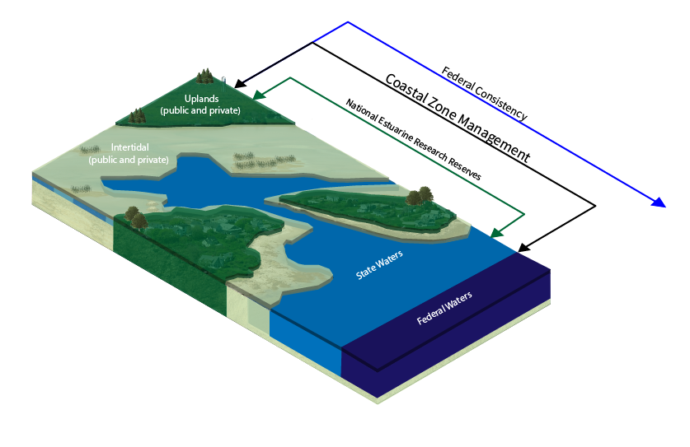
Basic Requirements
Establish boundaries
Define uses
Identify authorities
Designating areas of concern
Include public participation
Consider national interest
Establish organizational structure
Coordinate with all levels of governments
Notes:
The CZMA provides the flexibility states need to design programs that best address local challenges and work within state and local laws and regulations. This approach means state programs can be set up in a variety of ways, as long as the CZMA requirements are met. These requirements are outlined in Section 306 of the CZMA and include the need to
Establish coastal zone boundaries - Each state establishes a coastal zone boundary, which defines the areas where the coastal management program has regulatory and management interest.
Define types of land uses and water uses subject to the terms of the program.
Identify authorities to manage these uses, including policies that are enforceable.
Inventory and designated areas of particular concern in the coastal zone using a science- based process.
Incorporate public participation processes and approaches.
Consider national interests - States must provide for adequate consideration of activities that are important for regional and national purposes, e.g., defense activities, energy projects, navigation.
Ensure implementation and enforcement ability - Having an organizational structure to implement and enforce the state coastal management program.
Coordinate with government programs - Establishing a process for continued coordination between the program and governments at all levels.
This covers the basics in terms of program approach, goals, and design. Next up: information about why states create these programs and the roles the states and federal government play.
_______________________________________
Presenter - talk about your program:
Use a map to show your coastal management program’s coastal zone boundary.
Identify your program’s lead agency.

Slide 25
Benefits of Participation in the National Coastal Zone Management Program
National framework
Funding
Federal consistency
Program enhancement
Product and technical support
Notes:
The CZMA does not require states to create coastal management programs nor does it delegate authority to manage coastal land and water uses. Rather, states participate voluntarily and use their own authorities (sometimes through companion state coastal zone management legislation) to carry out their coastal management programs.
This approach begs the question – why do states participate in the national program? The CZMA provides a number of incentives, including the following.
A national framework and federal support for comprehensive statewide coastal management.
Funding for
program development,
program administration and implementation (including small scale construction and land acquisition), and
program enhancement efforts.
A framework to address emerging issues and long-standing challenges, through the Section 309 Coastal Zone Enhancement Program
The ability to ensure that federal actions (both within and outside a state’s coastal zone) that affect state coastal uses or resources are consistent with the state’s approved program through the federal consistency provision of the CZMA.
Access to helpful products and technical assistance.
Another reason not specifically addressed in the legislation concerns the benefits derived from being part of a national system that allows for peer-to-peer learning. For example, NOAA hosts national and regional meetings annually to encourage interaction among the programs.

Slide 26
Partnership
Notes:
The CZMA relies on a federal-state partnership approach to achieve coastal management goals. The program provides the means by which state and federal expertise, policies, and resources come together. The different roles of the entities (federal and state governments) are used to support one another and get the job done.
These roles are explored on the next few slides.

Slide 27
State Roles
Develop programs
Implement programs
Negotiate cooperative agreements
Enhance programs
Report semi-annually
Participate in program review
Coordinate with partners
Notes:
The state’s role is to implement. States work at the state and local level to implement coastal management programs.
They work with local communities, across state agencies, and in coordination with federal agencies. The focus on a partnership and coordination structure is designed to provide a catalyst for problem solving, partnership building, and on-the-ground changes.
Roles and activities include
Develop enforceable programs that meet the requirements of the Act and its regulations.
Implement coastal management programs including
Planning
Permitting and enforcement
Federal consistency
Land acquisition
Local and state capacity building
Education and outreach
Public involvement
Government coordination
Manage CZMA funding agreements. Each coastal program negotiates and implements an annual cooperative agreement with NOAA to receive program funding.
Implement 5-year strategies. Each program works to enhance their programs through 5-year strategies under the CZMA’s section 309 enhancement grant program.
Semi-annual reporting to cover implementation strategies and results.
Partner coordination, with a variety of partners, including the National Estuarine Research Reserves.
_______________________________________
Presenter - talk about your program:
Share examples of your role in implementing your state’s coastal management program.
Share examples of how CZMA funding is used in your program.
Include examples of the top priority areas and strategies from current assessment for your program.
Share when the last on-site evaluation occurred in your coastal management program.
Point out how many (if any) National Estuarine Research Reserves are in your state, the name(s) and any other important information.

Slide 28
Federal Roles - NOAA
Provides program development assistance
Approves programs and program changes
Provides program implementation funding
Supports state - federal coordination
Reviews assessments and strategies
Provides technical and governance assistance
Reviews program implementation
Adopts guidance, rules, and regulations
Notes:
The federal role is led by NOAA, who administers the National Coastal Zone Management Program and supports state implementation of the CZMA. (NOAA is under the Department of Commerce.) NOAA’s roles include
Providing program development technical and financial assistance.
Approving programs and subsequent program changes.
Providing program implementation funding.
Supporting state-federal coordination efforts.
NOAA provides general guidance to states as they implement Section 307 (federal consistency provisions).
NOAA interprets the federal consistency regulations.
NOAA mediates disputes between states and federal agencies on federal consistency matters.
NOAA conducts training on federal consistency.
Reviewing five-year, state-conducted assessments and enhancement strategies.
Providing technical assistance including management, policy, and conflict resolution.
Conducting a “continuing review” to ensure the state is implementing its program as approved, is addressing priority goals of the CZMA, and that CZMA funding is being used in a cost effective manner consistent with funding rules.
Adopting all necessary guidance, rules, and regulations.

Slide 29
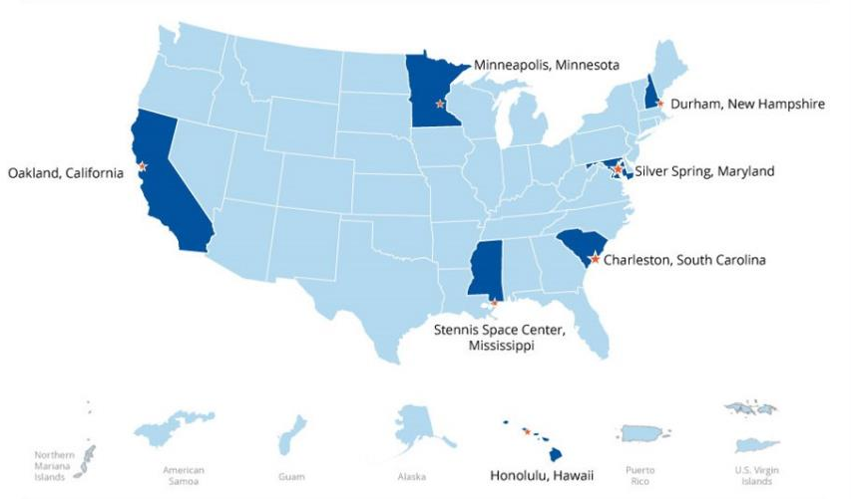
NOAA Office for Coastal Management
Notes:
NOAA’s Office for Coastal Management administers the National Coastal Zone Management Program.
In addition to all of the roles outlined on the previous slide, this NOAA office also provides significant coastal management support including data, tools, and training through the Digital Coast website and staff located around the country.
As a member of a coastal management program, you can reach out to NOAA staff for assistance.

Slide 30
The CZMA helps you help the coastal zone
Preserve
Protect
Develop
Coastal Zone
Enhance
Coastal Management
Programs
Connections
Restore
You are here
Coastal
States and
Territories
Federal
Partnership
Notes:
The work you do contributes to the national goals of the CZMA and is supported by the federal-state partnership created by the this legislation.
Let’s review some key points all coastal management staff should know about the CZMA.

Slide 31
Key Points 1
The CZMA was enacted in 1972 to preserve, protect and develop, and, where possible, to restore and enhance the resources of the coastal zone.
The CZMA created a voluntary partnership between NOAA and the states. The product of this partnership is a coastal management program.
The CZMA encourages states to develop and implement comprehensive, coastal land and water use planning and management programs.
Key Points
Notes:
The following summarizes the key points needed to have a basic understanding of the CZMA and the coastal management program framework, the federal-state partnership, and the national network of coastal management programs.

Slide 32
Key Points 2
Currently 34 of the 35 eligible states, U.S. territories, and commonwealths are implementing a federally approved coastal management program approved by the Secretary of Commerce.
The CZMA establishes a system of estuarine reserves called the National Estuarine Research Reserve System to enhance public awareness and understanding of estuarine areas, opportunities for public education, and for research to support the protection of these areas. There are 29 research reserves.
Key Points

Slide 33
Key Points 3
The CZMA includes a number of goals for coastal management programs to address. These include
protecting natural resources
managing development in high hazard areas
giving development priority to coastal-dependent uses
providing public access for recreation
improving coastal water quality
coordinating state and federal actions
involving the public
Key Points

Slide 34
Key Points 4
Coastal management programs are critical to achieving the national goals of the CZMA and form the foundation of a National Coastal Zone Management Program.
The CZMA authorizes funding to develop, implement, and enhance state-focused programs.
The CZMA provides flexibility to the states to design programs that best address local challenges and work within state and local laws and regulations, while also implementing the legislation’s requirements, such as identifying coastal zone boundaries and enforceable policies for managing land and water uses.
Key Points

Slide 35
Key Points 5
Under the CZMA states can ensure that federal actions that affect state coastal uses or resources (regardless of the location of the activity) are consistent with their approved program.
The CZMA requires an ongoing review of the state program to ensure it is being implemented as approved, is addressing priority goals of the CZMA, and that funding use is consistent with the rules.
The Coastal Nonpoint Pollution Control Program ensures that participating states have the necessary tools to prevent and control polluted runoff.
Key Points

Slide 36
Key Points 6
The CZMA establishes the Coastal Zone Enhancement Program, providing incentives to enhance the state program in nine areas: wetlands, coastal hazards, public access, marine debris, cumulative and secondary impacts, special area management planning, ocean and Great Lakes resources, energy and government facility siting, and aquaculture.
NOAA’s Office for Coastal Management administers the CZMA and provides on-going assistance to the states in regards to program implementation.
Key Points

Slide 37
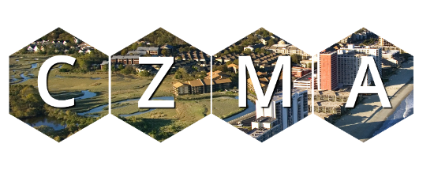
Support
Financial
Resources
Flexible
Structure
Voluntary
National
Network
Science
Based
Technical
Resources
Catalyst for
Problem
Solving
Support
Leverages
Resources
Coordination
Collaboration
Partnership
Community
Support
Proactive
Notes:
Knowing these key points helps you understand how your program fits within the national context and how you can access helpful resources.

Slide 38
Quiz
Don’t forget to take the quiz!
Notes:
Can you pass CZMA 101?
The quiz is 14 multiple choice or true/false questions with two extra credit questions.
https://coast.noaa.gov/digitalcoast/training/resources/czma-101.html

Slide 39
CZMA “good-to-know” sections
The following provides an overview of the “good-to-know” sections of the CZMA that will be useful to new or inexperienced staff.
This section can follow the previous presentation or be presented at another time.
CZMA Sections

Slide 40
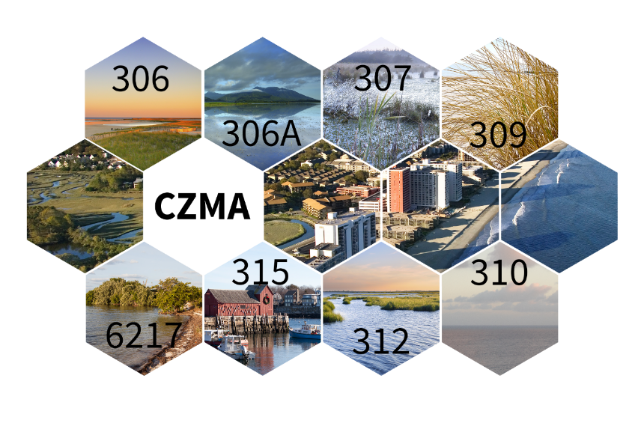
8 Good-to-Know Sections of the CZMA
8 Good-to-Know Sections of the CZMA
Notes:
Let’s take a moment to jump into some of the specific parts of the CZMA that play a role in developing and implementing a coastal management program. You’ll hear these terms around your office. Some people refer to these components by the corresponding section number in the legislation, others by the types of activities or programs the section focuses on. We will use both.

Slide 41
304: Definitions
Defines important terms used in the CZMA
Section 304
Notes:
Section 304 defines important terms used in the CZMA, such as “coastal zone,” “coastal resource of national significance,” “coastal waters,” “coastal state,” “coastal energy activity,” “energy facilities,” and “enforceable policy.”

Slide 42
Good to Know because a common understanding of the terms used is necessary for the successful development and implementation of a coastal management program.
Section 304
Notes:
Good to Know
Section 304 definitions are important because a common understanding of these terms is necessary for the successful development and implementation of a coastal management program.

Slide 43
306: Program Requirements and Implementation
Requirements for implementation, making changes to programs, and funding
Section 306
Notes:
Section 306 outlines requirements to be met for a state program to achieve federally-approved status and receive (and continue to receive) federal funding.
Programs use federal and state funding to support a variety of implementation tools including
Planning
Permitting and enforcement
Federal consistency
Land acquisition
Local and state capacity building
Education and outreach
Public involvement
_______________________________________
Presenter - talk about your program:
Show a map of your coastal management program boundary.
Include a chart showing how CZMA funding is used to fund implementation of the program.
If your program implements pass-through funding, include examples of outcomes of locally funded projects.

Slide 44
306: Good to Know
Good to Know because it helps explain
why coastal management programs include certain elements
how to update programs
why programs receive annual federal CZMA funding
Section 306
Notes:
Good to Know
Section 306 requirements provide a good overview of the program framework and explain often needed elements, such as coastal zone boundaries and how to implement program changes. This section also explains why programs receive annual CZMA funding support from the federal government.

Slide 45
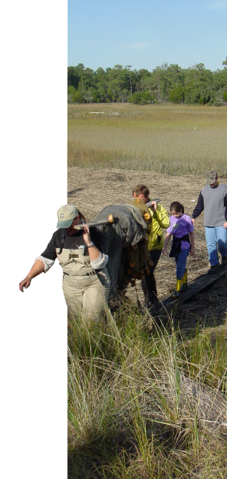
306A Coastal Resource Improvement Program
Section 306A
Funds for acquisition and construction projects
Notes:
Section 306A authorizes funding for acquisition and construction projects to improve coastal resources including coastal habitat and public access.

Slide 46
Good to Know because it explains what types of projects are eligible for 306A funding
Section 306A
Notes:
Good to Know
Section 306A tells you what types of projects are eligible for acquisition and construction project funding.

Slide 47
307: Federal Consistency
Facilitates cooperation and coordination with federal agencies to manage coastal activities and resources
Section 307
Notes:
Section 307, Coordination and Cooperation - more commonly known as the “federal consistency” provision, requires
federal agencies;
non-federal entities applying for required federal permits, licenses and other approvals; and
state and local government applicants for federal financial assistance
to conduct activities, within and outside the coastal zone, which have reasonably foreseeable effects on any coastal use (land or water) or natural resource of the coastal zone, in a manner consistent with the enforceable policies of state coastal management programs.
State programs use this unique and powerful tool to facilitate cooperation and coordination with federal agencies to manage coastal activities and resources. Many states consider this one of the stronger aspects of the CZMA - the ability to have a voice when federal actions are proposed by: federal agencies, applicants for federal permits, and state or local governments using federal dollars that affect coastal uses and resources.
_______________________________________
Presenter - talk about your program:
Add example of a recent federal consistency determination or certification made for a federal agency activity, license, or permit.

Slide 48
Good to Know
because it is a unique and powerful tool coastal management programs use to work with federal agencies to manage coastal activities and resources
Section 307
Notes:
Good to Know
Section 307, federal consistency, is a unique and powerful tool coastal management programs use to work with federal agencies to manage coastal activities and resources.

Slide 49
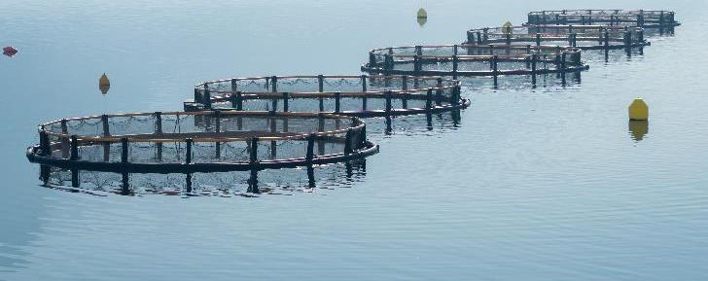
309: Coastal Zone Enhancement Grants
Provides funds to coastal states to make improvements in their coastal management programs
Section 309
Notes:
Section 309 establishes the Coastal Zone Enhancement Program, which provides funds to coastal states to make improvements in their coastal management programs in nine areas:
Public access
Wetlands
Hazards
Energy facility siting
Ocean governance
Cumulative and secondary impacts
Marine debris
Aquaculture
SAMPs (special area management plans)
Every 5 years a coastal program assesses these areas and develops new strategies where appropriate that result in changes that enhance program efforts. This process can help a program address long standing or emerging issues.
_______________________________________
Presenter - talk about your program:
Share examples of your coastal management program completed and current 309 strategies.

Slide 50
309: Good to Know
Good to Know because coastal management programs use these resources to address critical coastal issues
Section 309
Notes:
Good to Know
Section 309 is used to improve efforts to address critical coastal issues both long-standing and emerging.

Slide 51
312: Review of Performance
Program review every 5-7 years
Section 312
Notes:
Section 312 requires the review of state programs to ensure the state is
implementing its program as approved,
addressing priority goals of the CZMA, and
using CZMA funding in a cost effective manner consistent with funding rules.
NOAA typically conducts these reviews every five to seven years and provides evaluation findings and recommendations.

Slide 52
312: Good to Know
Good to Know
because it explains the 312 evaluation process.
Section 312
Notes:
Good to Know
Section 312 explains the evaluation process. Coastal management programs can use the results for program improvement.

Slide 53
315: National Estuarine Research Reserves System
Section 315
Notes:
Section 315 established the Estuarine Research Reserve System. This network of 29 coastal sites protects and studies estuarine systems.
The reserves include over 1.3 million acres of estuaries and are focused on the following.
Stewardship. Each site undertakes the initiatives needed to keep estuaries healthy.
Research. Reserve-based research and monitoring data are used to aid conservation and management efforts on local and national levels.
Training. Local and state officials are better equipped to introduce local data into the decision-making process as a result of reserve training efforts.
Education. Thousands of children and adults are served through hands-on laboratory and field-based experiences. School curriculums are provided online.

Slide 54
315: Good to Know
Good to Know
because reserves provide opportunities to collaborate and leverage education, training, research, and stewardship resources
Section 315
Notes:
Good to Know
Section 315, through the research reserves, provide opportunities to collaborate and to leverage education, training, research, and stewardship resources to support coastal management.

Slide 55
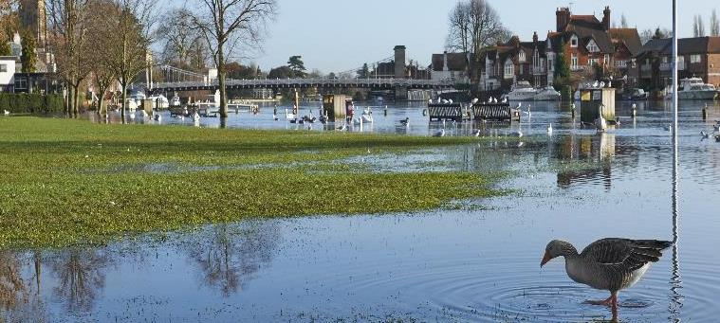
6217: Coastal Nonpoint Pollution Control Program
Manages the effects of nonpoint pollution in the coastal zone
6217
Notes:
Section 6217 covers nonpoint pollution control.
Section 6217 of the Coastal Zone Act Reauthorization Amendments of 1990 (CZARA), codified separately from the CZMA, requires states to develop programs and identify best practices to manage the effects of nonpoint pollution to coastal waters. This work is done in collaboration with state water quality, public health, agricultural, forestry, and other agencies and offices responsible for managing activities that can contribute to nonpoint pollution sources.

Slide 56
6217: Good to Know
Good to know
because the coastal nonpoint program helps states address this issue
6217
Notes:
Good to Know
Section 6217 provides information about one of the tools coastal management programs use to address nonpoint pollution.

Slide 57
CZMA Overview online
See CZMA Overview online for 2 quick references: 8 Good-to-Know Sections of the CZMA and Section-By-Section Description of the CZMA
Notes:
For ease of reference, NOAA provides two quick reference documents
A summary of the eight CZMA sections just described
A section by section description of the CZMA.
Detailed information on more CZMA topics, including a short quiz, can be found at Coastal Zone Management Act 101 (coast.noaa.gov/digitalcoast/training/resources/czma-101.html).
Additional CZMA information can be found on NOAA’s Digital Coast website (https://coast.noaa.gov/czm/act/).

